Slide 1
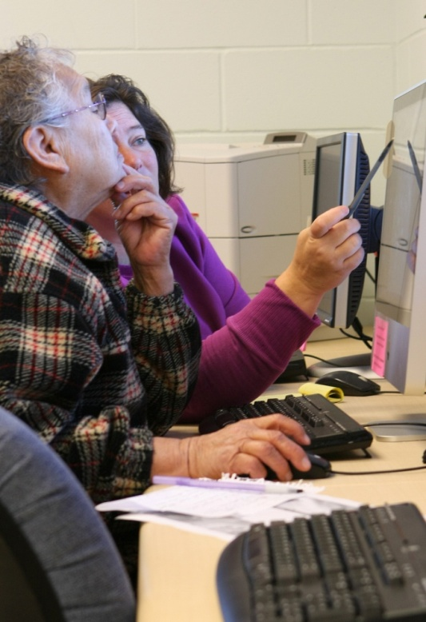
SUCCESS at Leech Lake Tribal College
April 27, 2011
Deborah LeClaire
Dean of Instruction
Leech Lake Tribal College
deborah.leclaire@lltc.edu

Slide 2
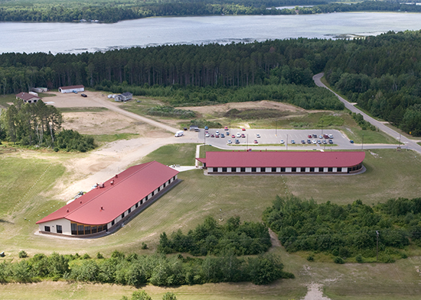
Leech Lake Tribal College
Mission: Leech Lake Tribal College provides quality higher education grounded in Anishinaabe values.
Vision: To be recognized as a center of academic excellence that advances the Anishinaabe worldview and empowers life-long learners who are fully engaged citizens, stewards, and leaders.

Slide 3
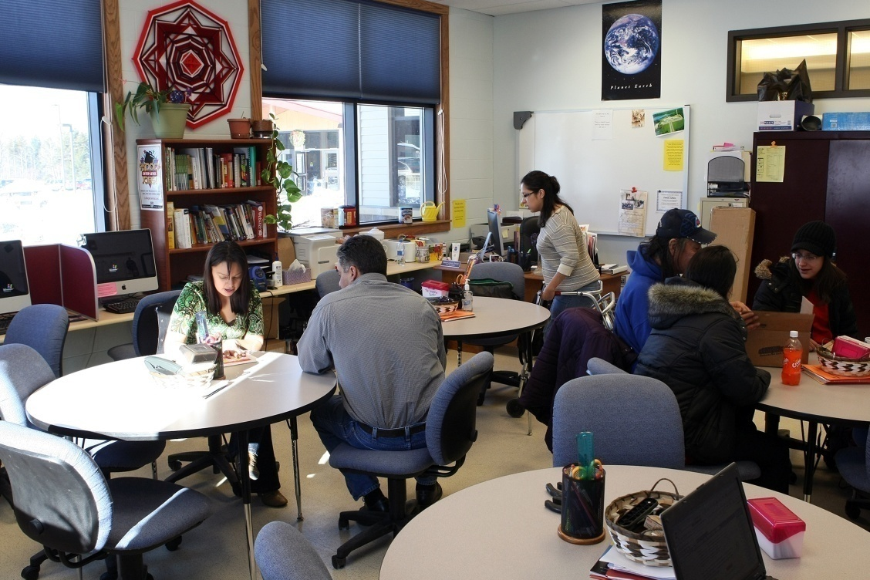
Student Success Initiatives
Notes:
Funded by a grant initially designed to raise intellectual capital in Indian Country. Grant proposed to raise student retention rates in math and English classes. Years 2004-2007 had a dismal 15 % of students passing English 101 and equally divided among failures and withdraws. Students talk about their experiences of being successful at LLTC as opposed to their other school experiences.

Slide 4
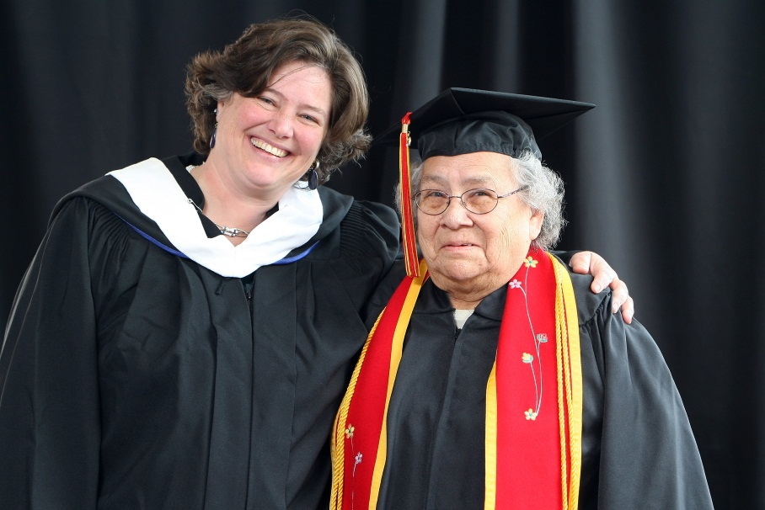
Path to success
Activities/practices should fit the STUDENTS in the institution.
Interdependence
Ojibwe Pedagogy

Slide 5
4 components of Ojibwe Pedagogy
1. Intake of Information
2. Reflection
3. Experiential Learning
4. Learner Becomes Teacher/Model
(Linda LeGarde Grover)
Notes:
Tell story about Jeremy coming in for coffee, getting creamer, coming to school next year.
Time for learner’s reflection as tutor—even more here
What this means for tutor training. Task performed after a degree of mastery when learner ready.
Very important role in Ojibwe culture. Usually older.
If you look at these you see that it gives rise to the question what is the independent learner? What do we mean when we say that? What do we suggest to students when we use those words?
Briefly talk about the boarding school era and dysfunction and suspicion that has come in its wake.

Slide 6
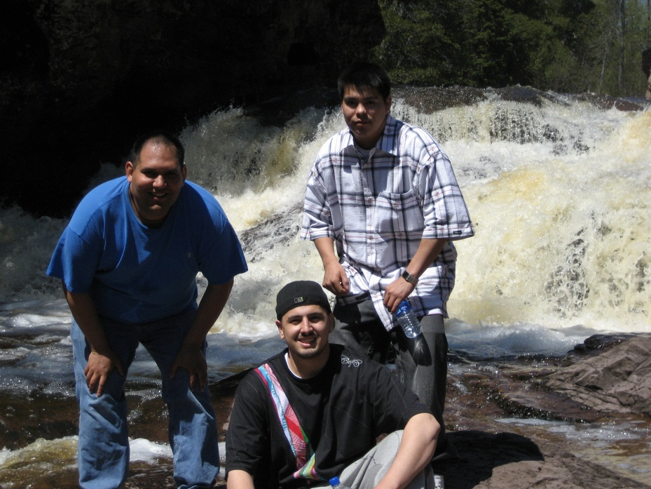
Path to success
Facilitating student to student interaction is imperative.
Change of Student Success Course
Peer tutors in math classrooms
Tutor transition training
Lunch and Learns

Slide 7
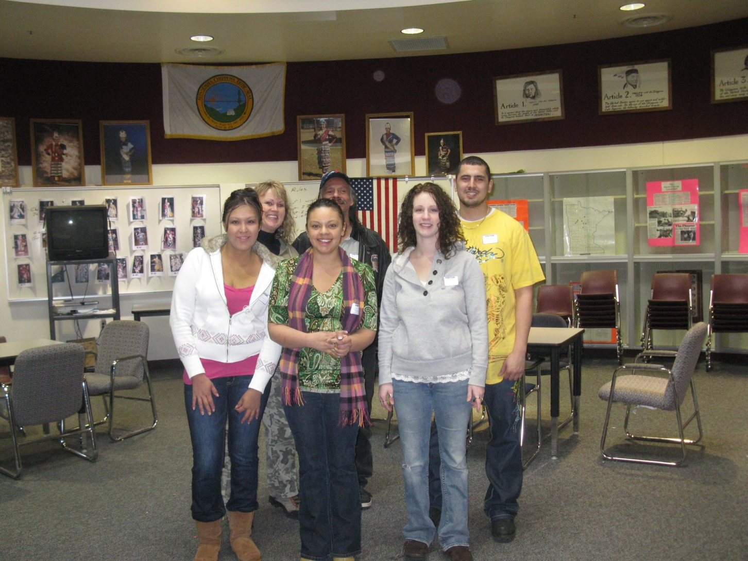
Path to success
Having students engage in service significantly increases belief in self as an important and essential part of the group.
Day of Peace: service learning
Differences between High School and College
Talking Circle

Slide 8
Path to success
Faculty and student services personnel serve together on steering committees.
Academic and Student Services Collaborative committee
Quick needs to know email system between academics and student services
Shared vision statement and how it will be actualized
Anything that deconstructs habits of isolation
Advising Week/ Student Orientation Planning
Career Day

Slide 9
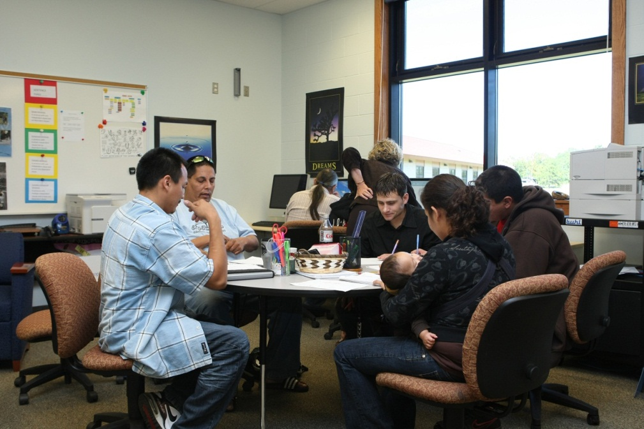
Path to success
Faculty should be involved in retention / ‘student services’ activities.
Faculty in Learning Center
Miikinaa: The PATH Lecture Series Documentary
http://www.youtube.com/watch?v=1lBRS4VI4sk

Slide 10
Path to success: keep trying
Financial Literacy Plan
Academics
Financial Aid
Student Services
Office of Community and Continuing Education
Mikiinaa: The Path
Challenges with meeting with mentors at commuter campus environment
All challenges that come with working with First Generation college students

Slide 11
first year transitions are more successful with….
Data driven plans
Interdepartmental communication
Student to student relationships
Activities that students can attend alone but that encourage interaction
Mentors available outside of offices
Activities that help students learn HOW TO LEARN
Activities that break down the silos, explicitly reveal the ‘hidden’ expectations and lessen culture shock
Activities that help student feel PART OF THE GROUP

Slide 12
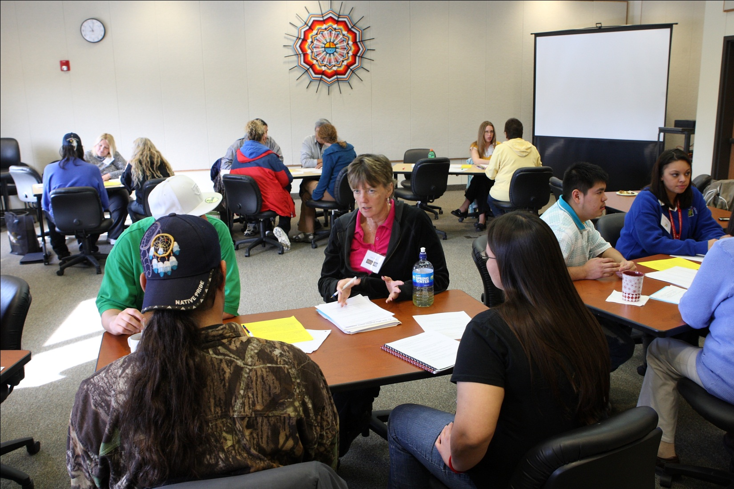
Mii-gwech!

